Slide 1

REAL-TIME NETWORK ANALYTICS WITH STORM
Mauricio Vacas
Fausto Inestroza
Sonali Parthasarathy

Slide 2








The Team
Mauricio Vacas
Big Data Architect
Anita Mehrotra
Data Scientist
Fausto Inestroza
Big Data Architect
Krista Schnell
Visualization
Sonali Parthasarathy
Real-Time Processing
Susie Lu
Visualization
Rick Drushal
Engineering Lead
John Akred
Product Lead

Slide 3
WHY REAL-TIME?

Slide 4
PROCESS
Real-Time Data Ingestion
Exploratory Analytics
UNDERSTAND
Model Prototyping
Real-Time Rule Execution
REACT
Distributed Analytics

Slide 5
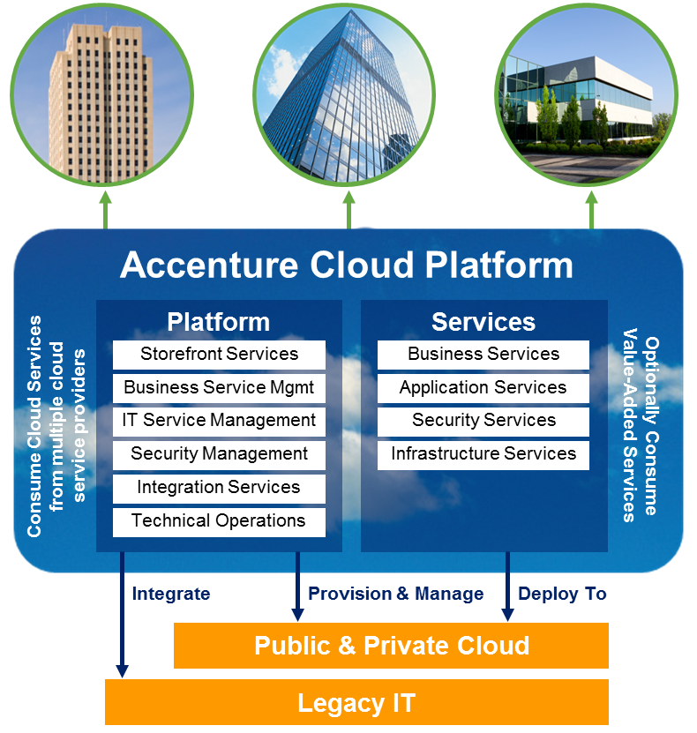
Accenture Cloud Platform
Recommender as a Service
Network Analytics Services
…
Big Data Platform

Slide 6
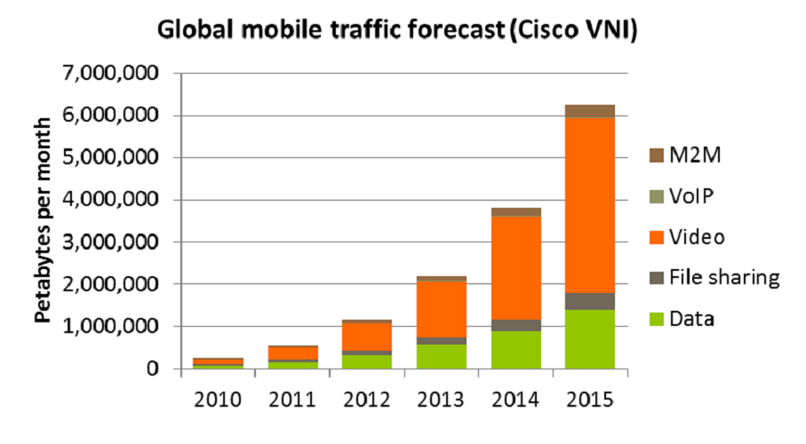
Drivers
consumer devices
video usage
Issues
Operational Costs
Understanding service quality degradation
Inefficient capacity planning

Slide 7











VISUALIZE
INGEST
PROCESS
STORE
ANALYZE

Slide 8
WHY STORM?

Slide 9
What do we need?
Multiple use cases
Processing, computation, etc.
Data types, size, velocity
Scalability
Mission critical data
Fault-tolerance
Time series / pattern analysis
Reliability

Slide 10
How do we get this from Storm?
Processing, computation, etc.
Low-level Primitives
Scalability
Parallelization
Fault-tolerance
Robust fail-over strategies
Reliability
Processing guarantees

Slide 11
PRIMITIVES

Slide 12




Suboptimal network speed, geospatial analysis
Topology
Stream
Request info (IP, user-agent, etc)
Tuple
Tuple
Spout
Pull messages from distributed queue
Bolt
Sessionization, speed calculation

Slide 13
PARALLELISM

Slide 14
Supervisor
W
T
T
Nimbus
W
Zookeeper
T
T
Supervisor
W
T
T
W
T
T

Slide 15
Topology
Worker Process
Executor
Executor
Task
Task
Task
Task

Slide 16
FAULT TOLERANCE

Slide 17
Supervisor
W
T
T
Nimbus
W
T
T
Supervisor
Supervisor
W
W
T
T
T
T
T
T
W
W
T
T
T
T
T
T

Slide 18
RELIABILITY

Slide 19

IP1
IP2
IP2
IP3
A

Slide 20
IP1
IP2
IP2
IP3
A

Slide 21
Suboptimal Network Speed Topology
An Example

Slide 22
Kafka
Spout
Pre-process
Sessionize
Calculate N/W Speed per Session
Update Speed per IP
Identify Suboptimal Speed
Store in Cassandra
Tuple (ip 1)
Tuple (ip 1)
Tuple (ip 1)
Tuple (ip 1)
Tuple (ip 1)
Tuple (ip 1)
Tuple (ip 1)
Cassandra

Slide 23
Parallelism
Kafka
Spout
Pre-process
Sessionize
Calculate N/W Speed per Session
Update Speed per IP
Identify Suboptimal Speed
Store in Cassandra
Tuple (ip 1)
Tuple (ip 1)
Tuple (ip 1)
Tuple (ip 1)
Tuple (ip 1)
Tuple (ip 1)
Tuple (ip 1)
Tuple (ip 1)
Tuple (ip 1)
Cassandra
Tuple (ip 2)
Tuple (ip 2)
Tuple (ip 2)
Tuple (ip 2)
Tuple (ip 2)
Tuple (ip 2)
Tuple (ip 2)
Tuple (ip 2)
Tuple (ip 2)

Slide 24
Branching and Joins
Kafka
Spout
Pre-process
Sessionize
Calculate N/W Speed per Session
Update Speed per IP
Join
Compare Speed
Store in Cassandra
Stream 1
Tuple (ip 1)
Tuple (ip 1/NY)
Tuple (ip 1/NY)
Cassandra
Tuple (NY)
Stream 2
Kafka
Spout
Speed by Location

Slide 25
Rule Execution

Slide 26


METHOD 1
Storm
METHOD 2
Storm + Drools
Drools

Slide 27
Storm + Drools
Kafka
Spout
Pre-process
Sessionize
Calculate N/W Speed per Session
Update Speed per IP
Identify Suboptimal Speed
Store in Cassandra
Drools
Cassandra

Slide 28
Integration with Cassandra
Cassandra
Optimal for time series data
Near-linear scalable
Low read/write latency
Custom Bolt
Uses Hector API to access Cassandra
Creates dynamic columns per request
Stores relevant network data

Slide 29
Lessons Learned
Rebalance Topology
Tweak Parallelism in bolt
Isolation of Topologies
Use TimeUUIDUtils
Log4j level set to INFO by default

Slide 30
DEMO

Slide 31
Next Steps
Trident
Externalizing Rules
Predictive Models
Real-Time Notifications

